Slide 1

Used Car Price Prediction
A Machine Learning Approach to Fair Market Valuation
Presented by: Vansh Kumar

Slide 2
The Challenge: Pricing Opacity in the Used Car Market
1
2
3
The Challenge
The Objective
Success Metric
The used car market suffers from pricing opacity
Build a data-driven Machine Learning model to predict the "Fair Market Value" of a vehicle
Minimize the Root Mean Squared Error (RMSE)
Sellers struggle to price competitively
Maximize the R² score to explain price variance
Buyers fear overpaying
Traditional valuation methods often fail to account for the complex, non-linear interaction between vehicle age, power, and condition

Slide 3
Data Foundation & Preparation
Data Source
omitted_data_cars_sampled.csv (Cleaned subset)
Volume
~33,000 Total Records
Split: 70% Training / 30% Testing
Preprocessing Pipeline
Cleaning Rows with missing values were removed to ensure data integrity
Transformation The target variable (price) was Log-Transformed (np.log) This is crucial because car prices are right-skewed (many cheap cars, few expensive ones) The log transform normalizes this, helping the model learn better
Encoding Categorical features (Fuel Type, Gearbox) were One-Hot Encoded

Slide 4
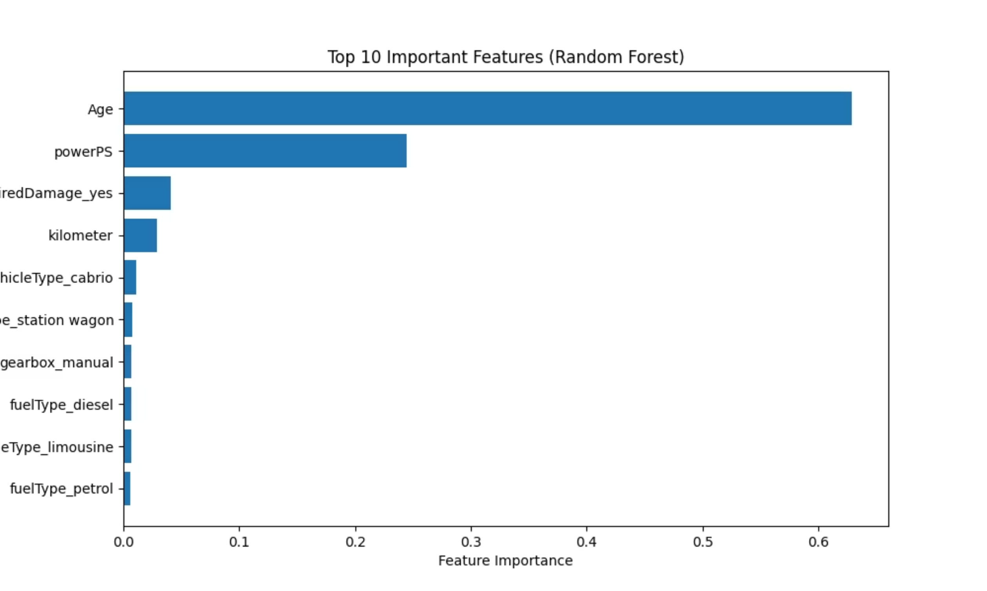
Key Insights from EDA (Feature Importance)

Slide 5
Feature Importance Analysis
Dominant Predictors:
Condition Matters:
Minor Factors:
Age: The single most critical factor in depreciation. The model heavily relies on this to determine the baseline price.
notRepairedDamage_yes: This specific flag is the 3rd most important feature. A car with unrepaired damage drastically reduces the predicted value, outweighing features like brand or fuel type.
Fuel type (diesel vs petrol) and transmission (manual) play a role but are secondary to Age and Power.
PowerPS: Engine power is the second strongest driver of value.

Slide 6


Model Development & Optimization
Our predictive model is built using a Random Forest Regressor algorithm.
Phase 1: Baseline Model
Phase 2: Tuning (RandomizedSearchCV)
Settings: n_estimators=220, max_depth=87
Tested 100 combinations of parameters using 3-Fold Cross-Validation
Issue: Severe Overfitting. The model memorized the training data (R²=0.96) but struggled to generalize effectively
Optimal Parameters: n_estimators=52, max_depth=110, min_samples_split=100
Logic: Setting min_samples_split to 100 forced the trees to be simpler, preventing them from isolating specific outliers

Slide 7
Model Performance & Diagnostic Analysis
Performance Metrics (Tuned Model)
Test R² Score: 0.82 (The model explains 82% of the price variance)
Test RMSE: ~4,269 (Average prediction error in currency units)
Generalization: The gap between Train RMSE (4244) and Test RMSE (4269) is negligible, proving the model is robust and not overfitting

Slide 8
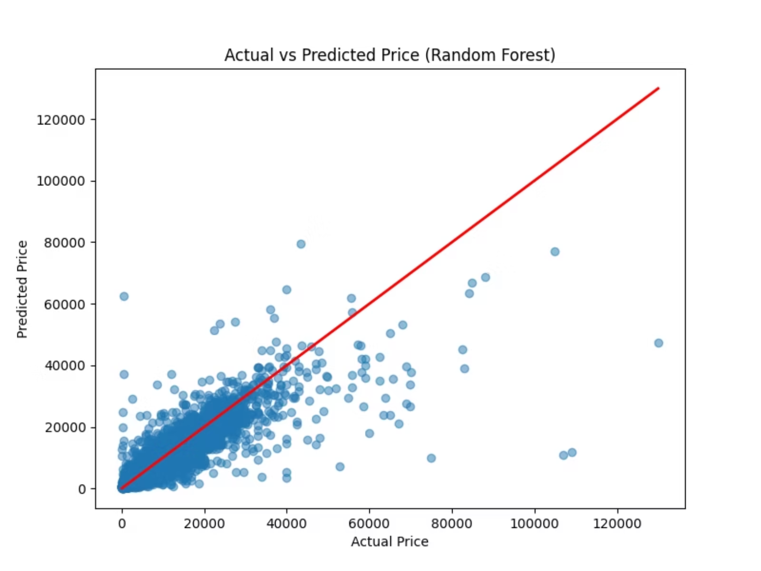
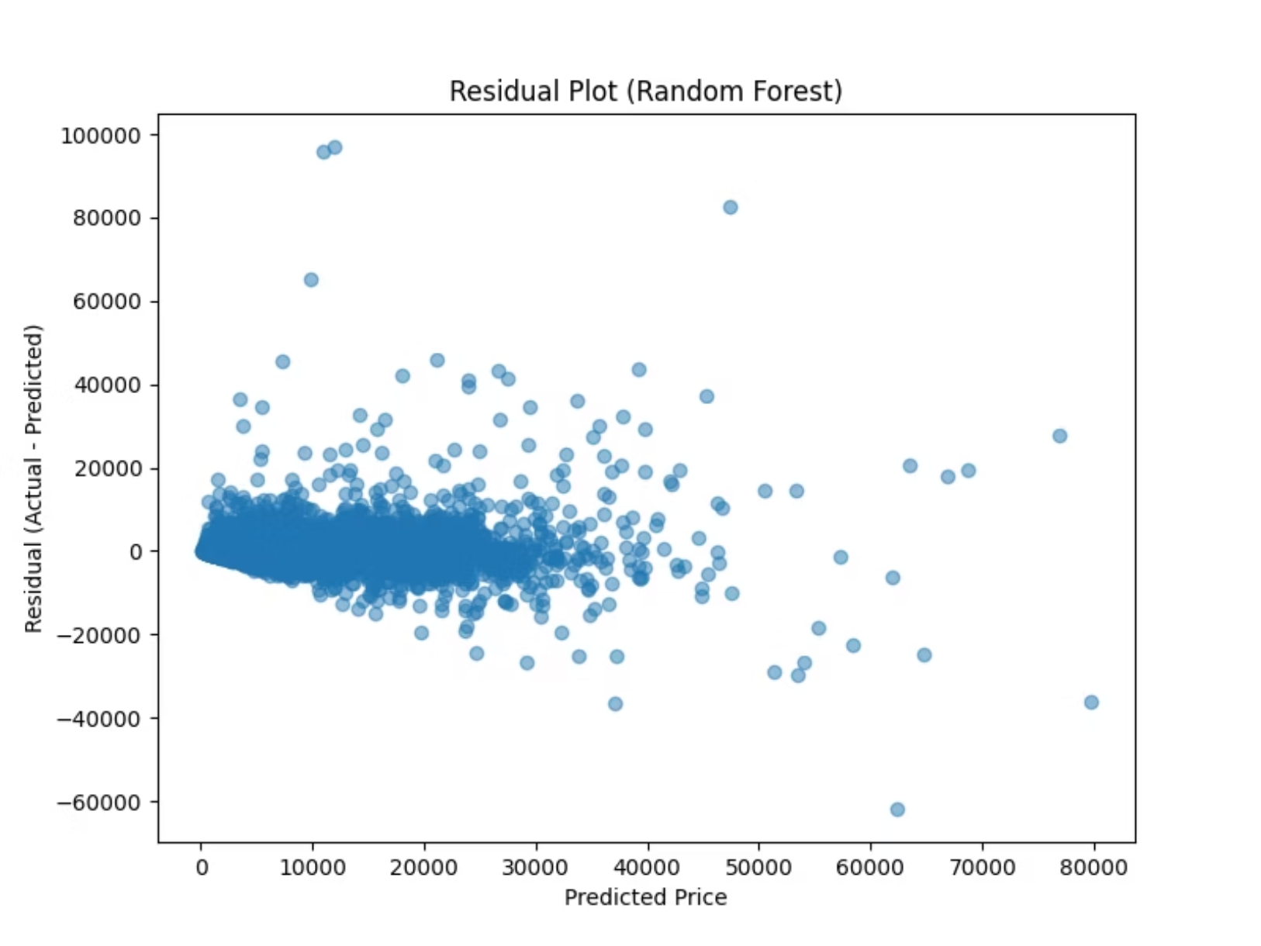
Visual Analysis
Actual vs. Predicted Plot
Residual Plot
Shows a strong linear correlation along the red diagonal line, indicating high accuracy for the majority of vehicles.
The residuals cluster densely around 0, which is ideal.
Outliers: There are visible outliers where the residual is negative (Actual < Predicted) or positive (Actual > Predicted), likely due to rare collector cars or data entry errors in the dataset.
Deviation: The model struggles slightly with ultra-high-value cars (top right corner), often under-predicting their price.

Slide 9
Conclusions & Strategic Recommendations
Conclusion
1
We successfully moved from an overfit baseline model to a generalized tuned model
The model confirms that Age, Horsepower, and Damage Status are the "Holy Trinity" of used car valuation
With an R² of 0.82, the model is reliable for mass-market vehicles
Recommendations
Deployment The model (best_random_forest_model.pkl) is ready for API integration
2
Business Rule Implement a "Manual Review" flag for cars predicted above $60,000, as the visual plots show higher variance in that range
Future Work Re-introduce Brand and Model columns using Target Encoding to capture the "Luxury Brand Premium" that PowerPS alone cannot explain

